Slide 1


K. RAMAKRISHNAN COLLEGE OF ENGINEERING
(AUTONOMOUS), SAMAYAPURAM – TRICHY
DEPARTMENT OF CSE(ARTIFICIAL INTELLIGENCE AND MACHINE LEARNING)
AGC1341- MOBILE APPLICATION DEVELOPMENT
TDEE CALCULATOR
PRESENTED BY
BARATH P (8115U24AM014)
RAGHUL K (8115U24AM043) SUPERVISOR
RITHIK MOHAN P (8115U24AM045) Mr.P.Nagaraj
SANJAYKUMARAN B (8115U24AM046) Assistant Professor / AIML

Slide 2
PRESENTATION OVERVIEW
Abstract
Project Introduction
Objective
Literature Survey
Research gap
Existing System and Proposed System
Tools & Technologies
Architecture Diagram
Modules Used
Output Screenshots
Conclusion and Future Scope
References

Slide 3
ABSTRACT
TDEE Calculator is a mobile application designed to help users understand and manage their daily calorie requirements.
It provides a simple platform to calculate Total Daily Energy Expenditure (TDEE) based on personal details and physical activity levels.
Users can enter their age, gender, height, weight and activity level to calculate their daily calorie needs.
The application helps users set fitness goals such as weight loss, weight gain and weight maintenance.
The application aims to promote healthy lifestyle habits through personalized calorie calculations and effective fitness planning.

Slide 4
PROJECT INTRODUCTION
Users can enter personal details such as age, gender, height, weight and activity level to calculate their daily calorie requirements.
The application calculates BMR (Basal Metabolic Rate) and TDEE (Total Daily Energy Expenditure) based on the user's information.
Personalized calorie recommendations are provided for weight loss, weight gain and weight maintenance.
Users can understand their daily energy needs and plan their fitness goals effectively.
The application provides a simple and user-friendly interface to support healthy lifestyle habits.

Slide 5

OBJECTIVE
To develop a mobile-based application for calculating daily calorie requirements based on personal details.
To provide an accurate calculation of BMR (Basal Metabolic Rate) and TDEE (Total Daily Energy Expenditure).
To help users plan their daily calorie intake according to weight loss, weight gain and weight maintenance goals.
To provide personalized calorie recommendations based on different physical activity levels.

Slide 6
LITERATURE SURVEY
Existing fitness applications provide features for calculating BMR, TDEE and daily calorie requirements.
Calorie tracking applications help users monitor their daily food intake and maintain a balanced diet.
Fitness applications provide activity tracking features to estimate calories burned through physical activities.
Health monitoring systems allow users to track weight, body measurements and fitness progress.

Slide 7
RESEARCH GAP
BMR calculation, TDEE calculation and calorie tracking are often handled through separate applications.
Personalized calorie recommendations may not be directly connected to fitness goal management.
Activity-based calorie estimation and weight management can exist as separate functions.
The TDEE Calculator addresses this gap by providing an integrated mobile application for BMR calculation, daily calorie estimation and personalized fitness goal planning..
.

Slide 8
EXISTING SYSTEM AND PROPOSED SYSTEM
Existing System | Proposed System
BMR and TDEE calculations may require separate online tools. | Provides an integrated BMR and TDEE calculator.
Users may manually calculate their daily calorie requirements. | Automatically calculates daily calorie needs based on personal details..
Physical activity levels may not be considered accurately. | Calculates TDEE based on different activity levels.
Users may not receive personalized calorie recommendations. | Provides calorie recommendations for weight loss, weight gain and maintenance.
Fitness progress may be tracked using different applications. | Provides a simple platform to understand daily calorie requirements and fitness goals.
.

Slide 9
TOOLS & TECHNOLOGIES
Flutter – Used to design and develop the cross-platform mobile application.
Dart – Programming language used to implement application logic and TDEE calculation functionality.
Material UI – Used for building an attractive and user-friendly application interface.
Local Storage – Used to store user details and calculation results.
Android Studio – Development environment used to build, run and test the mobile application.
.

Slide 10
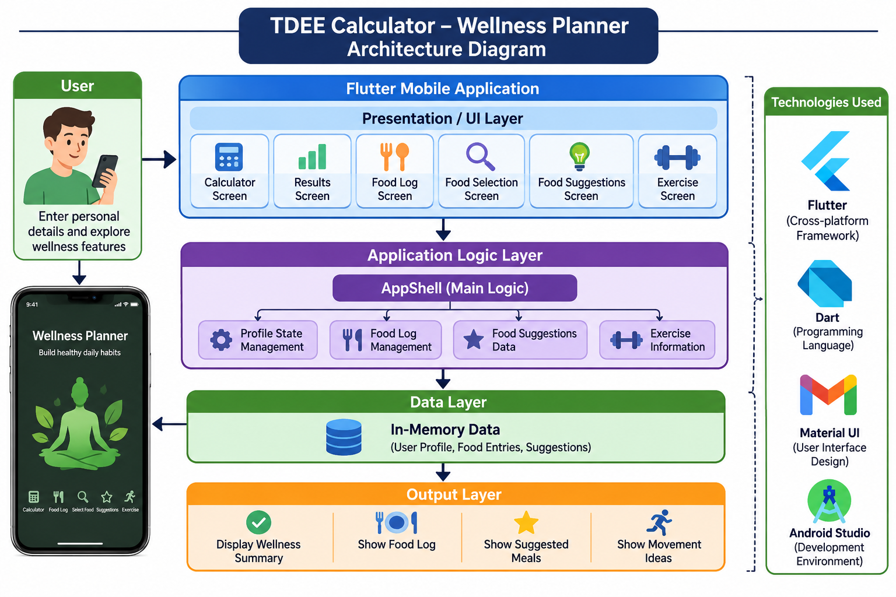
ARCHITECTURE DIAGRAM
.

Slide 11
MODULES USED
1. User Profile Module
Collects user details such as age, gender, height and weight.
Allows users to select their physical activity level.
Provides wellness focus options.
2. Calculator Module
Accepts personal information from users.
Manages user inputs for wellness profile creation.
Provides access to the wellness summary.

Slide 12
MODULES USED
  3. Results Module
Displays the user's wellness profile.
Shows age, height and weight details.
Provides healthy habit suggestions.
4. Food Selection Module
Allows users to search for food items.
Displays available food options.
Supports adding selected foods to the food log.

Slide 13
MODULES USED
5. Food Log Module
Records selected food items.
Organizes food entries into breakfast, lunch, dinner and snacks.
Allows users to remove food entries.
6. Food Suggestions Module
Displays suggested meals.
Provides meal categories and filters.
Supports different wellness focus options.

Slide 14
MODULES USED
7. Exercise and Movement Module
Displays different physical activities.
Provides walking, cycling, dancing, stretching and swimming suggestions.
Shows flexible activity duration guidelines.
8. Navigation Module
Provides bottom navigation between application screens.
Allows users to switch between different modules.
Maintains a smooth application experience.

Slide 15
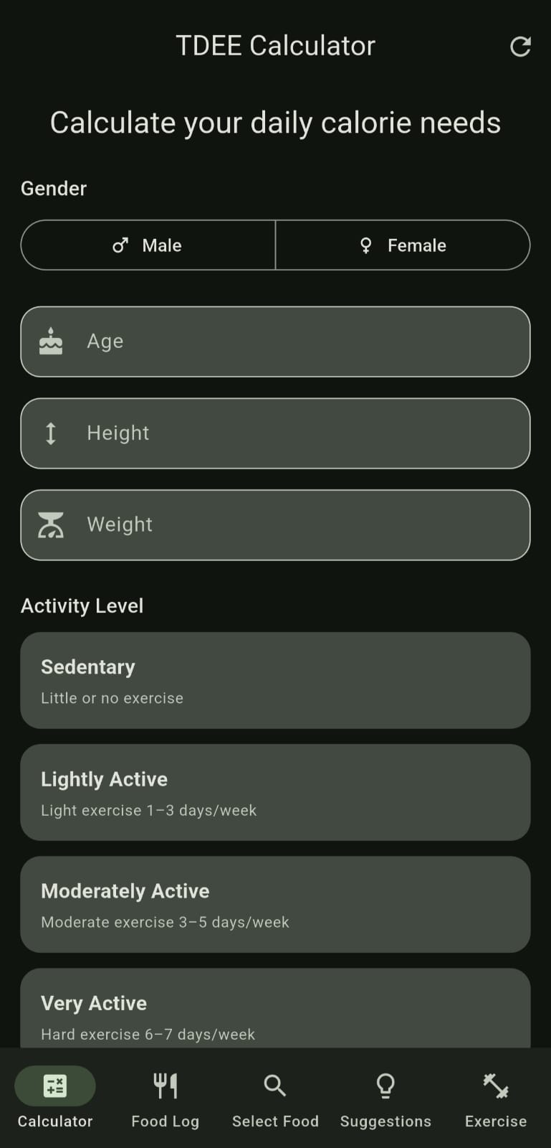
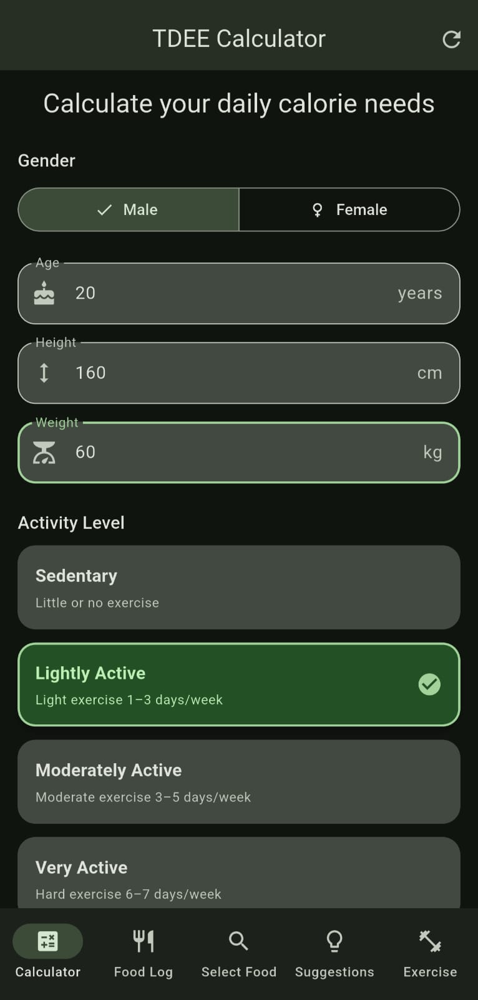
OUTPUT SCREENSHOTS

Slide 16
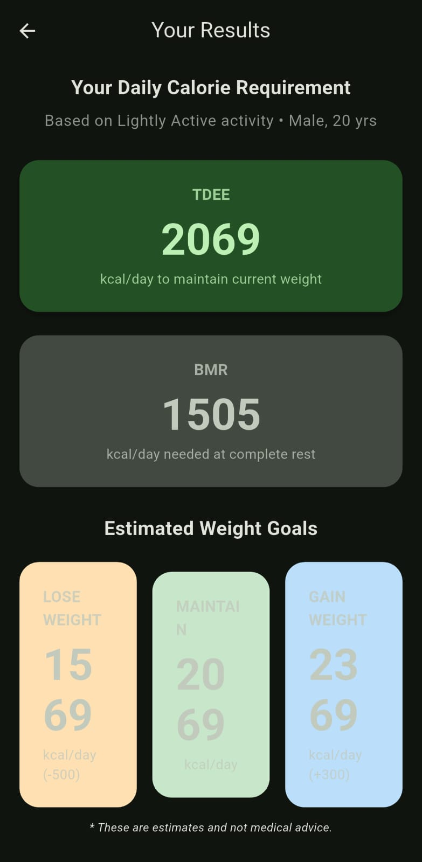
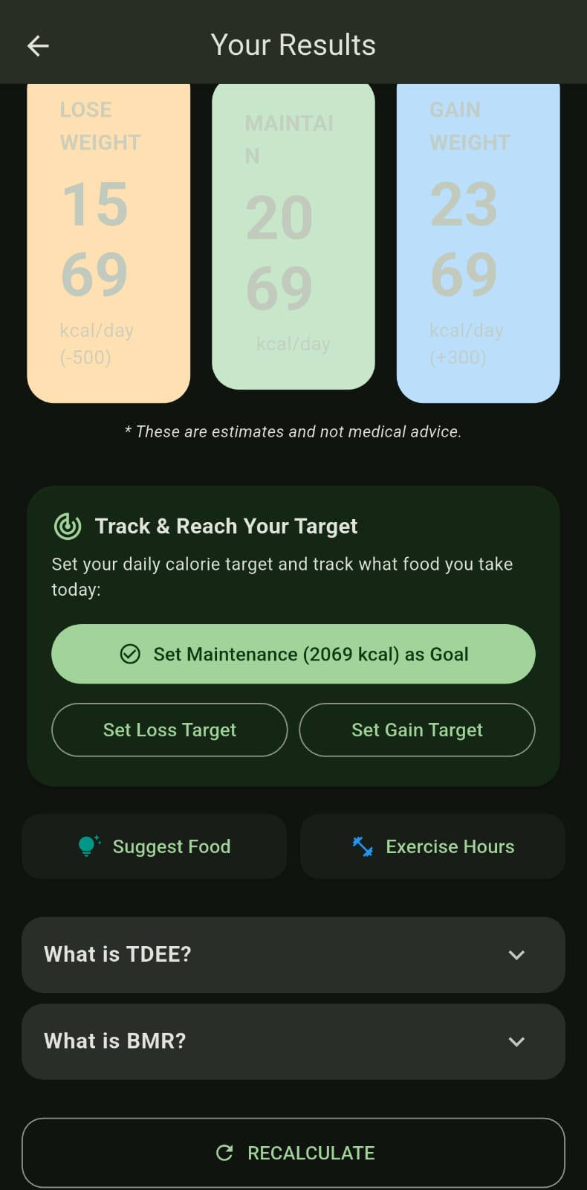
OUTPUT SCREENSHOTS

Slide 17
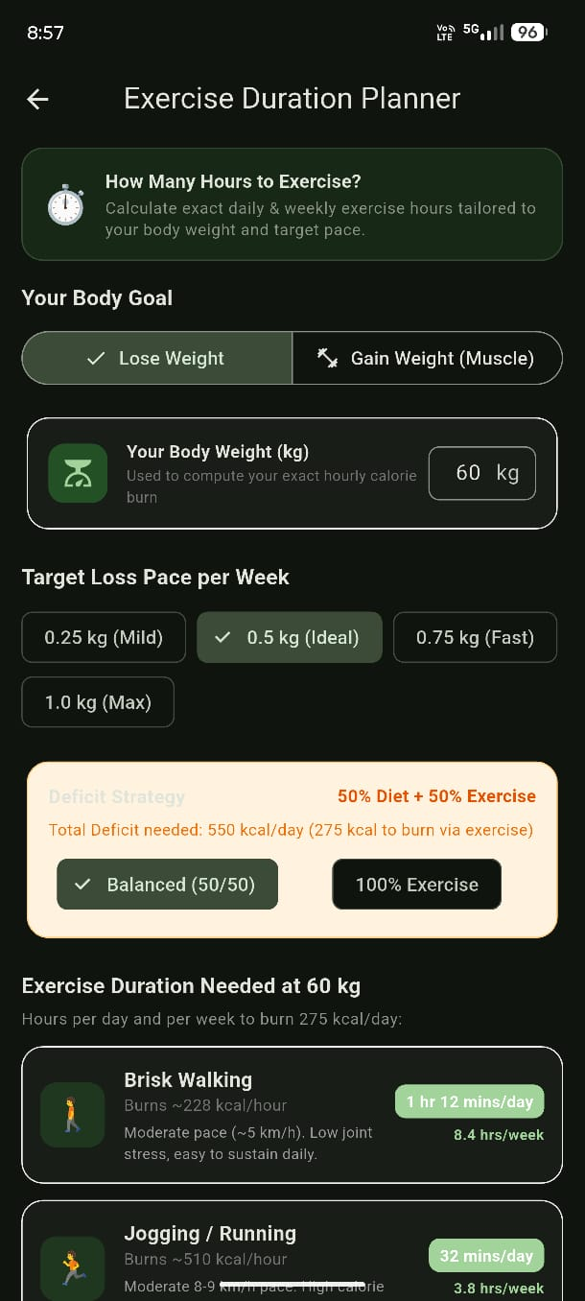
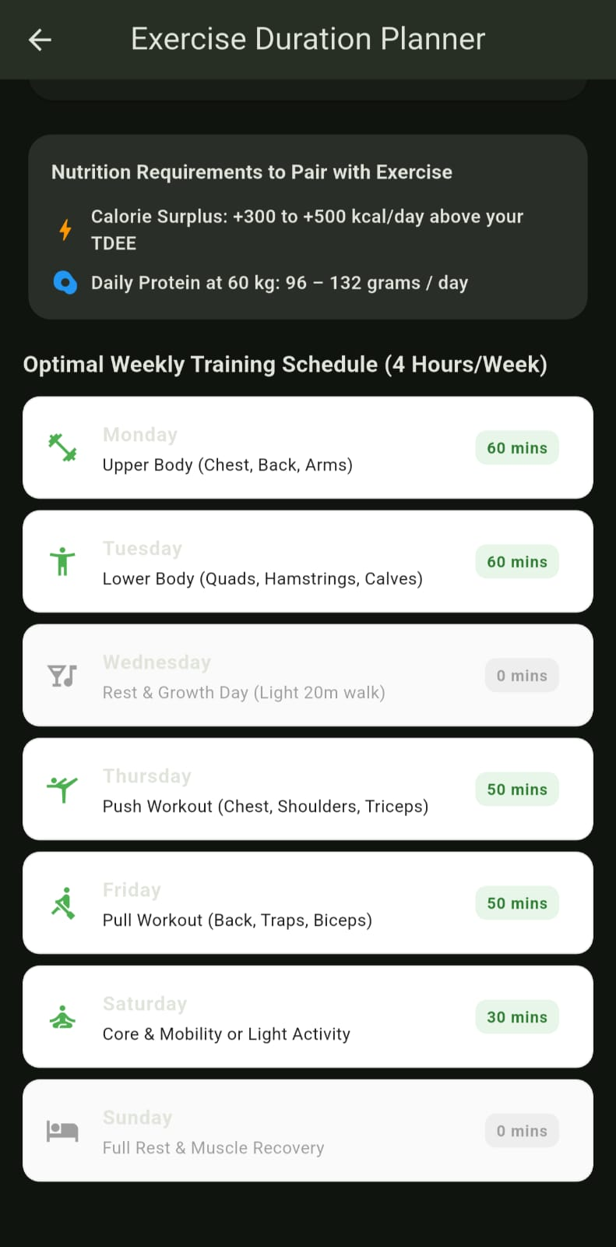
OUTPUT SCREENSHOTS

Slide 18
CONCLUSION AND FUTURE SCOPE
The TDEE Calculator – Wellness Planner provides a centralized mobile application for managing personal wellness information.
The application combines user profile management, wellness summaries, food selection and exercise suggestions.
Food logging functionality helps users record and organize their daily meals.
Flutter and Dart provide the required framework for application development and user interface management.
The modular design allows the application to be extended with additional features such as actual BMR/TDEE calculations, health tracking and personalized wellness recommendations.

Slide 19
REFERENCES
1. Flutter Documentation – Programming language framework and cross-platform mobile application development.
2. Dart Documentation – Programming language reference and application logic development.
3. Flutter Material Documentation – User interface components and mobile application design.
4. Android Developers Documentation – Android Studio, application building, testing and deployment.

Slide 20


